Slide 1
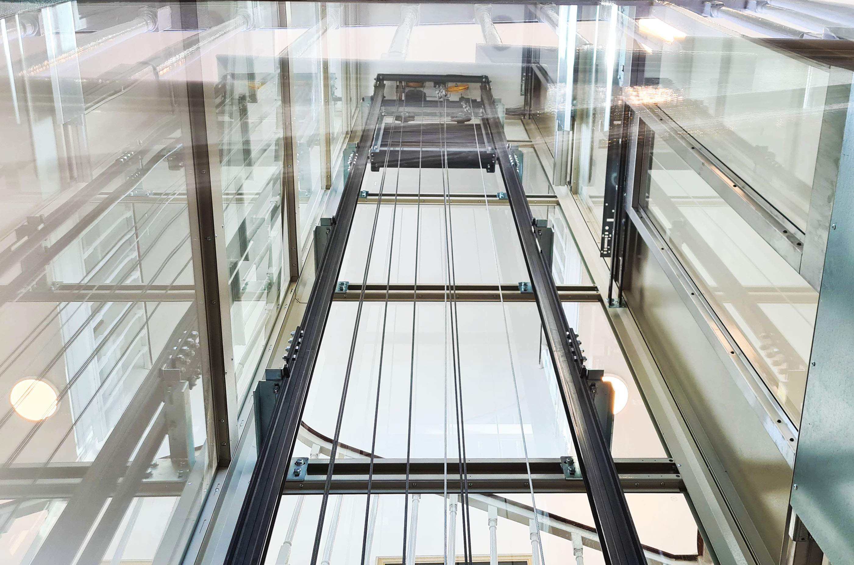


Slide 2



Our Evolution
2017
2010
2006
2004

Slide 3
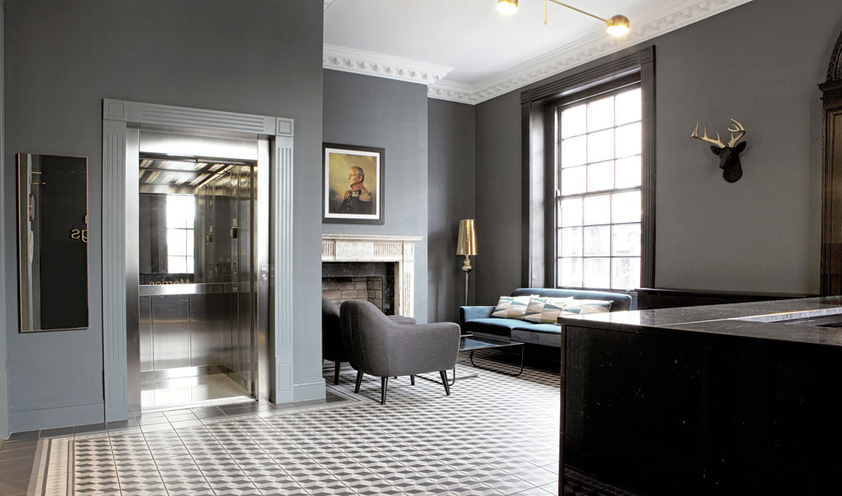
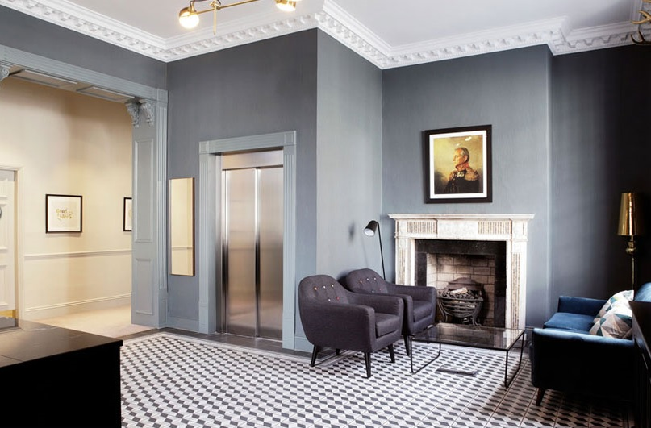
Independent Lift Co. Ltd is an Irish owned company fully certified to supply, install, inspect and test quality European manufactured lift equipment. We also maintain all leading manufacturers’ lift equipment.
‘Independent Lift Co. Ltd’ has achieved accreditation for our ‘ISO9001:2008 Quality Management System’. We have also achieved accreditation for the ‘European Communities (Lifts) Directive 1998 (95/16/EC)’.
We apply the European CE mark to all our Installations.

Slide 4
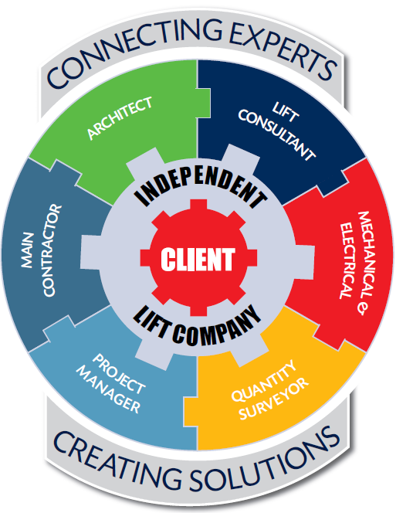
We consult carefully with our customers to understand their particular business requirements in detail, before developing bespoke lift solutions with their professional design teams.
We specify and source the most suitable lift equipment, and work closely with the project delivery team to ensure a safe and efficient installation on site.
The successful handover of a high quality lift installation incompliance with all required lift regulations is always our ultimate objective. Our lift installation process for the supply, installation and final test of new passenger lifts within the scope of EN81-20, EN81-21 and EN81-50 is carefully managed, audited annually and certified by a European Notified Body for compliance with the Lift Regulations.

Slide 5
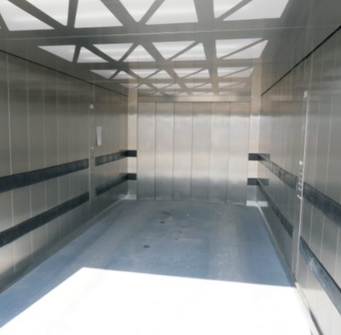
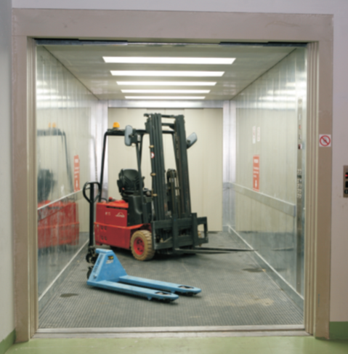
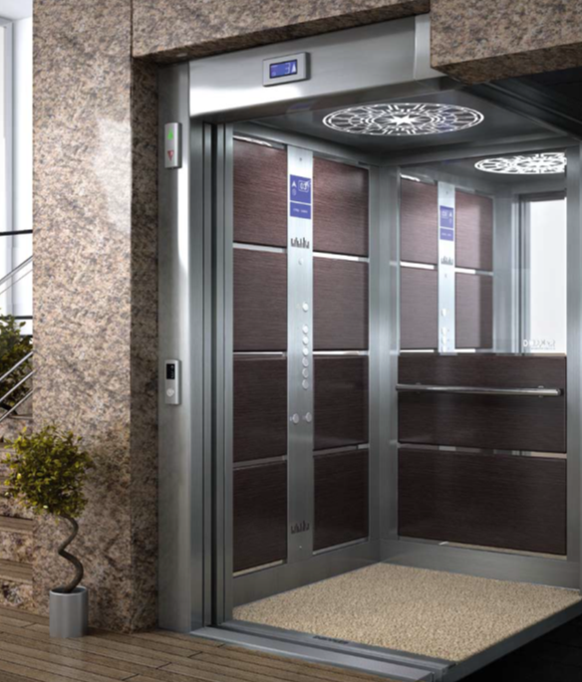
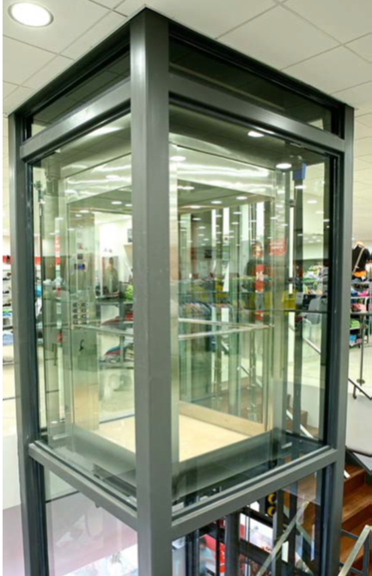
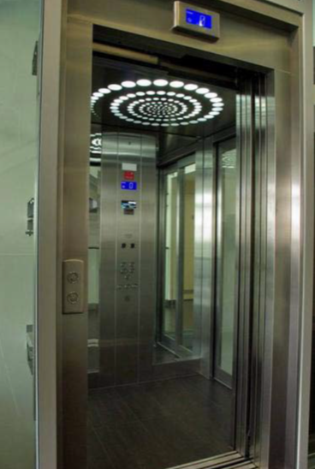
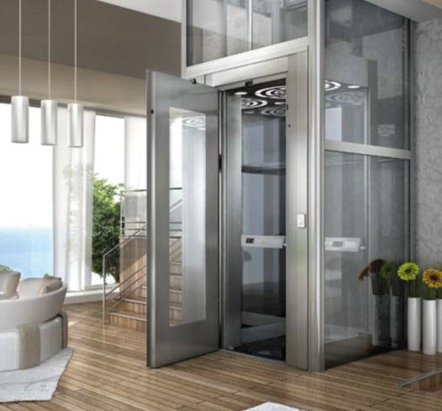
PRODUCTS
Installation of Lift Directive EN81-Lifts including:
Passenger Lifts
Goods Lifts
Panoramic Lifts
Document M compliant lifts ISEN81-70
Fire fighting Lifts ISEN81-72
Passenger evacuation lifts En81-76
2. Installation of Machinery Directive Lifts (2006/42/EC) including:
Goods only Lifts
Goods with trained operative lifts.
Scissors Lifts
Platform Lifts for persons with impaired mobility. (2006/42/EC & Part M building regulation & EN81-41)

Slide 6
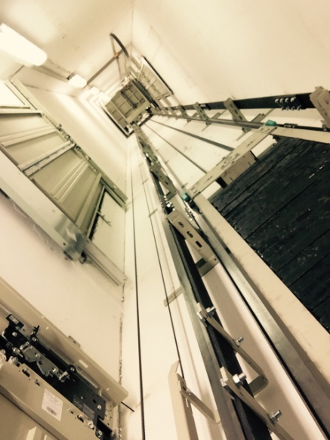
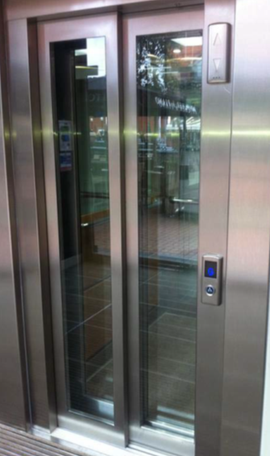
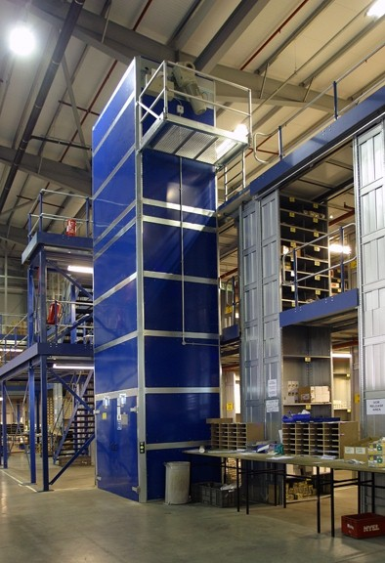
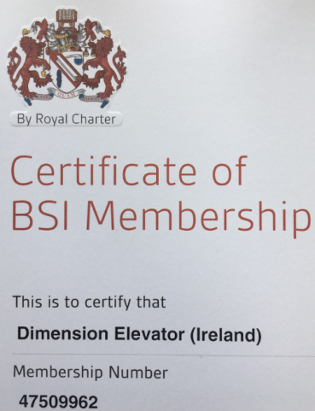
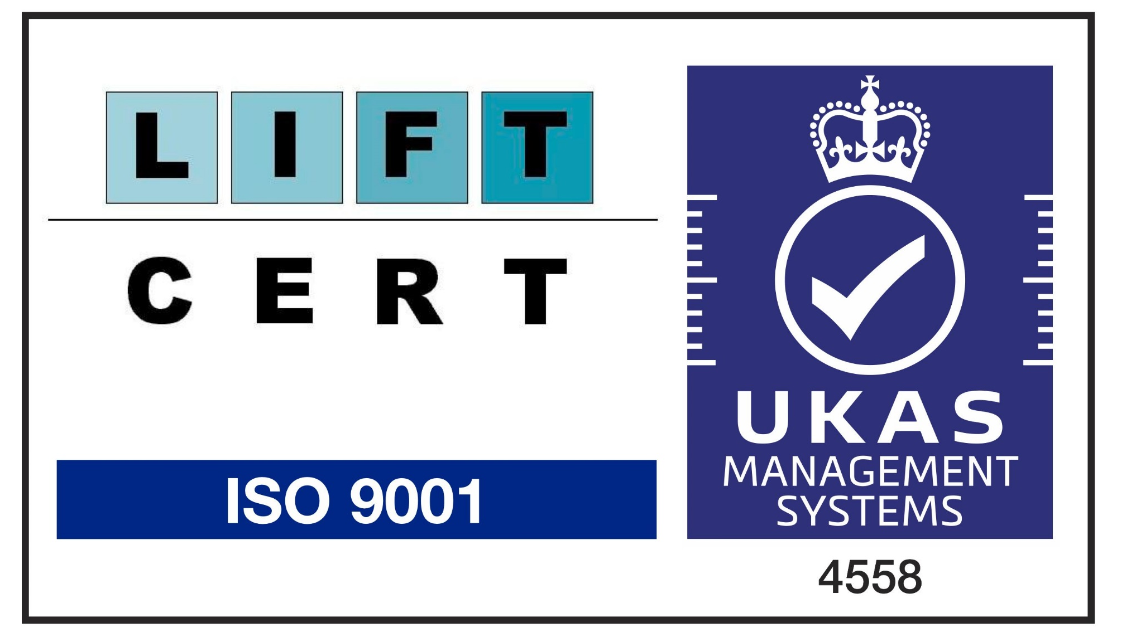


Slide 7
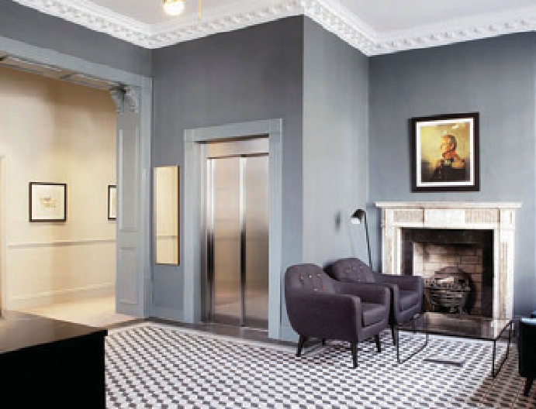

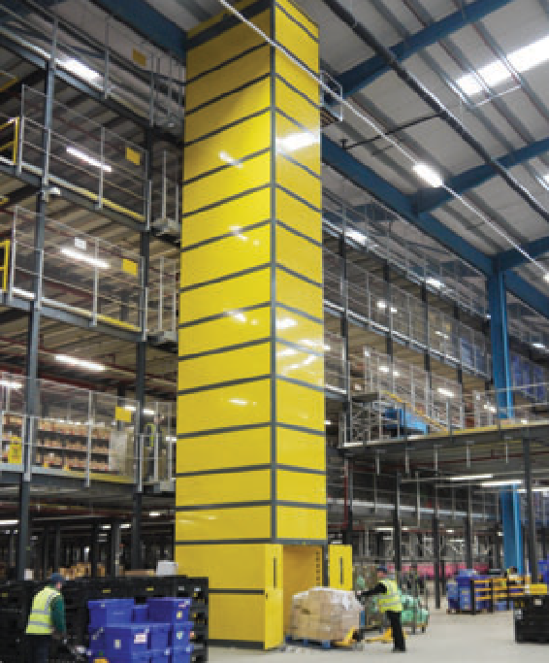
WE BEST SOURCE
Independent Lift Company Ltd has sourced and approved quality European lift manufacturers to provide specialist lift solutions for our customers. We offer competitive advantage, through our long standing partnerships with these suppliers, who have both innovative products and an understanding of what is required for the European and Irish lift market. All our suppliers are qualified and rated using our ISO 9001 Quality management system.
WE BEST DELIVER
WE BEST SUPPORT
We consult carefully with our customers to understand their particular business requirements in detail, before developing bespoke lift solutions with their professional design teams.
We specify and source the most suitable lift equipment, and work closely with the project delivery team to ensure a safe
and efficient installation on site.
The successful handover of a high quality lift installation in compliance with all required lift regulations is always our ultimate objective. Our lift installation process for the supply, installation and final test of new passenger lifts within the scope of EN81-20, EN81-21 and EN81-50 is carefully managed, audited annually and certified by a European Notified Body
for compliance with the Lift Regulations.
Independent Lift Co. Ltd is also a “Service and Maintenance” provider, offering “Service Level Agreements” tailored to the specific site requirements of our customers.
We provide complete product life cycle partnership, from handover of the lift installation, through an extended warranty period, to preventative maintenance.
We also provide Repair and Refurbishment services to keep your lifts operating at optimum performance in order to serve the ever changing needs of a modern building

Slide 8
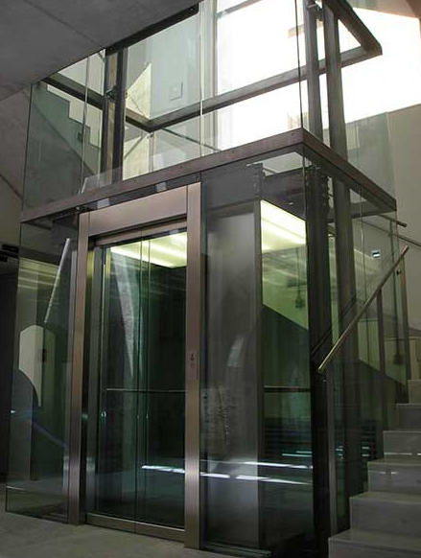
SERVICE AND MAINTENANCE
Independent Lift Company provides complete product lift cycle partnership.
Benefits of Service agreement:
Preventative maintenance in line with ISEN81-80
Service level : Standard
24 Hour call out service
Spare part availability
24/7 communication link
Review biannual insurance reports on customer behalf;
Make recommendations for action on same.

Slide 9







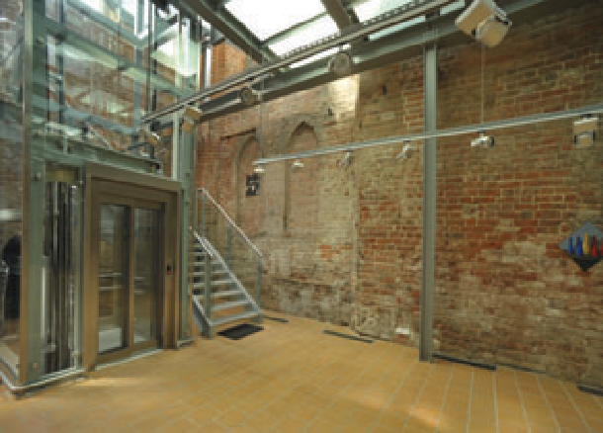
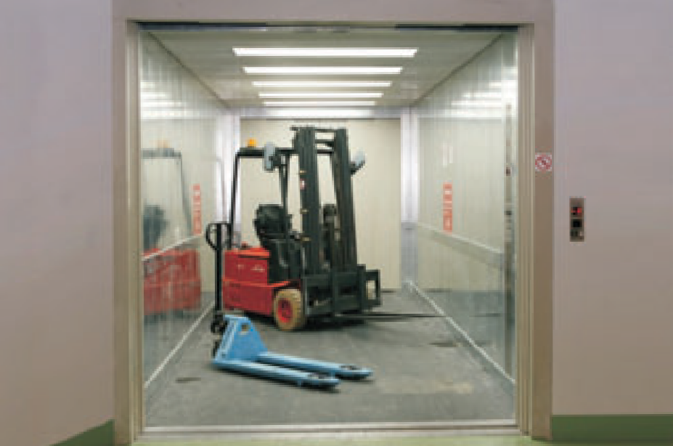
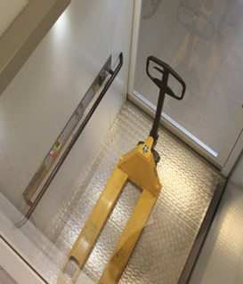
SPECIALIST LIFT SOLUTIONS
INSTALLATION
Lift Directive EN81-Lifts including
Passenger Lifts
Evacuation Passenger Lifts EN81-76
Goods / Passenger Lifts Panoramic Lifts
Document M compliant lifts ISEN81-70 Fire fighting Lifts ISEN81-72
Car Lifts
Machinery Directive Lifts (2006/42/EC) Including
Goods only Lifts
Goods Lift with trained operative. Scissors Lifts
Platform Lifts for persons with impaired mobility. (2006/42/EC & Part M Building Regulation & EN81-41)
Repairs and Refurbishment
Installation of new lifts.
Installation of new lifts in existing buildings. Refurbishment of existing lifts.
Repairs to existing lifts
Removal and disposal of existing lifts

Slide 10
New Products 2023
Dock Levellers
Dock Shelter
Sectional Doors
Steel Doors

Slide 11
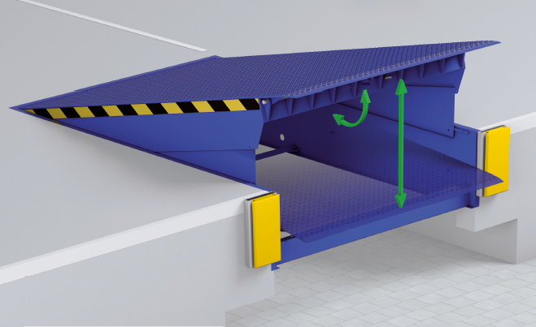
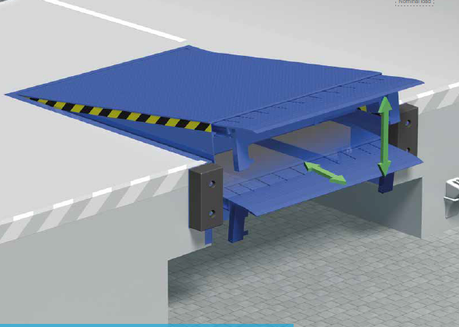
Dock Levellers
The hydraulic dock levellers with a telescopic lip are optimised for the increased market requirements and combine the advantages of various systems. They are particularly robust and allow for efficient loading thanks to state-of-the-art control technology.

Slide 12
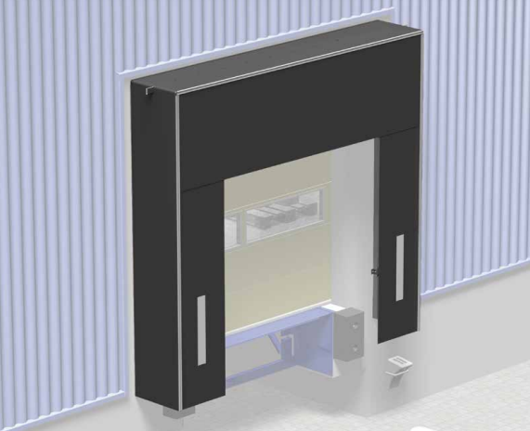
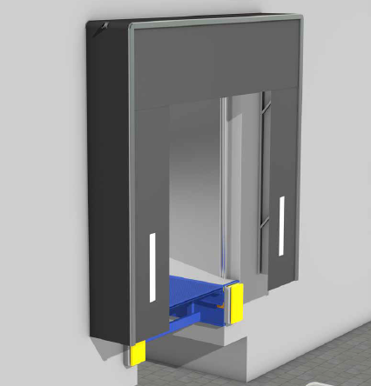
Dock Shelter
To prevent heat loss in the hall and to protect the goods
from rain at the loading point, dock shelters are used.
We offer a wide range of solutions in the area of dock shelters,
such as inflatable dock shelters, aluminium dock shelters and many more.This is a dock shelter that was specially developed for loading sprinters. Thanks to our wide range of products, we can offer you the right dock shelter for your individual requirements, so that you are excellently equipped against draughts and rain.

Slide 13
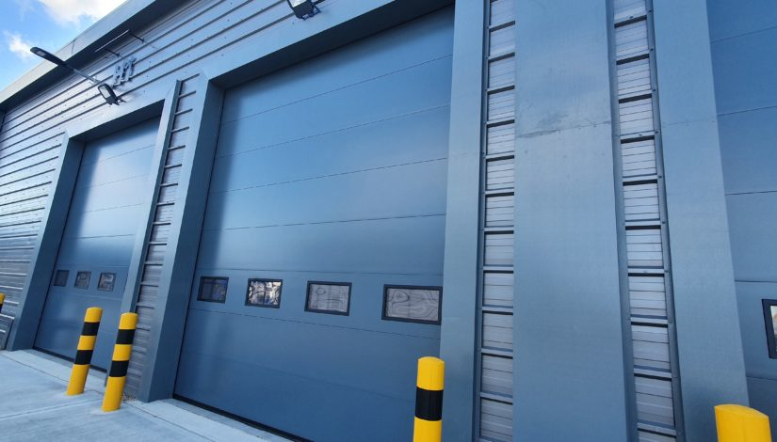
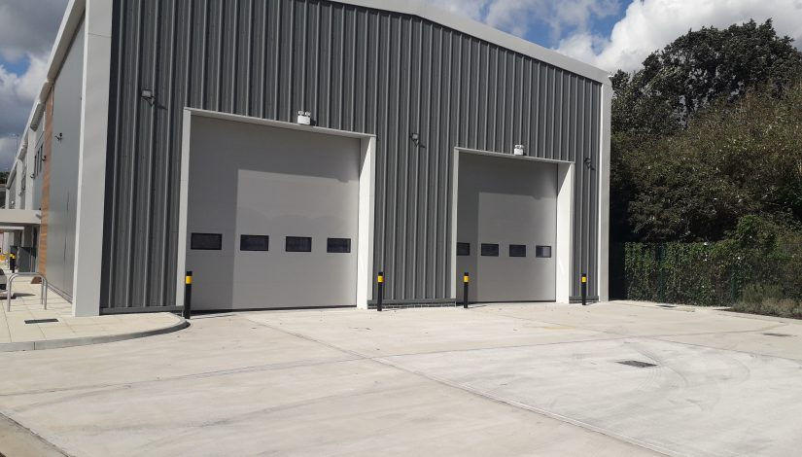
Sectional Doors
The door combines excellent heat-insulating and sound-absorbing properties with modern design, mainly micro profiled but stucco and smooth-profiled panels are also available. The possibilities in design and detailing are very wide, which makes the door perfectly configurable for every situation.

Slide 14
Independent Lift Co Ltd.
D13
M4 Interchange Business Park
Maynooth Road
Celbridge
Co Kildare
W23 K85Y
T: 01 6270006
info@iLift.ie
Thank you for your attention!

